Slide 1

Networking Lab (Final)
Assignment
Prepared by:
Antor Hawlader
ID: 222071024
Dept: CSE
Batch: 30th
8th Semester
Submitted to:
Dr. Md. Rabiul Islam, Professor,
Department of CSE & CSIT SMUCT
Shanto Mariam University of Creative Technology
Department: CSE
CSE-3286: Networking Lab [A]

Slide 2
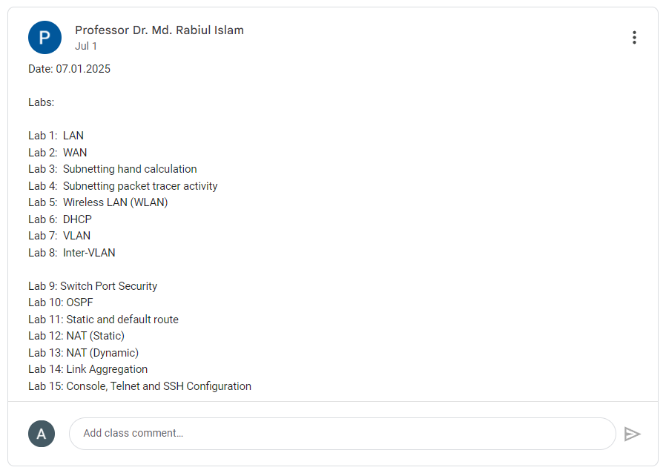

Slide 3
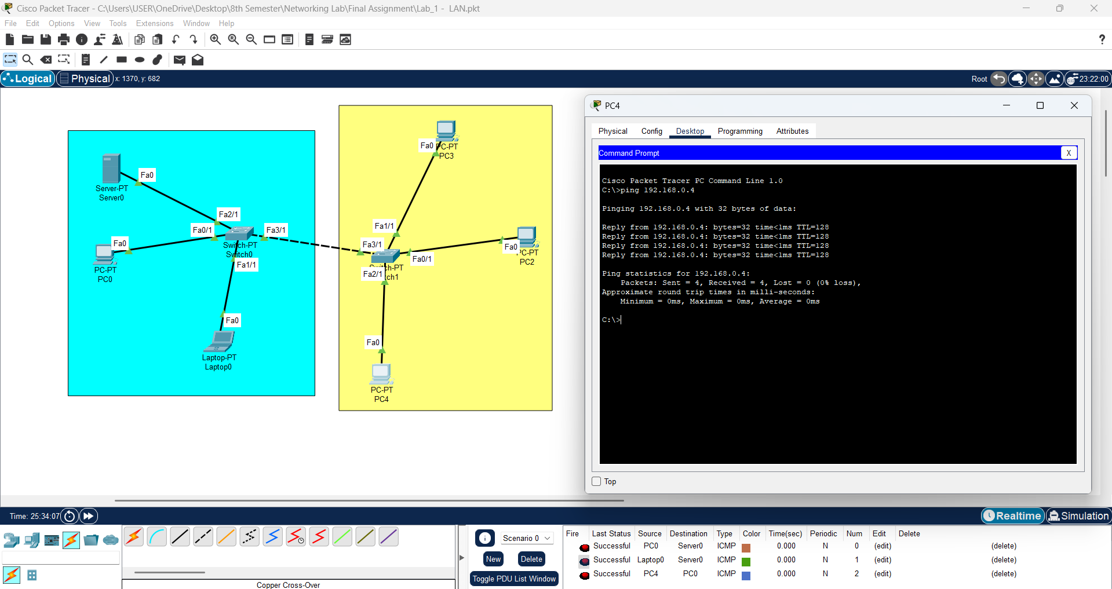
Lab 1 - LAN

Slide 4
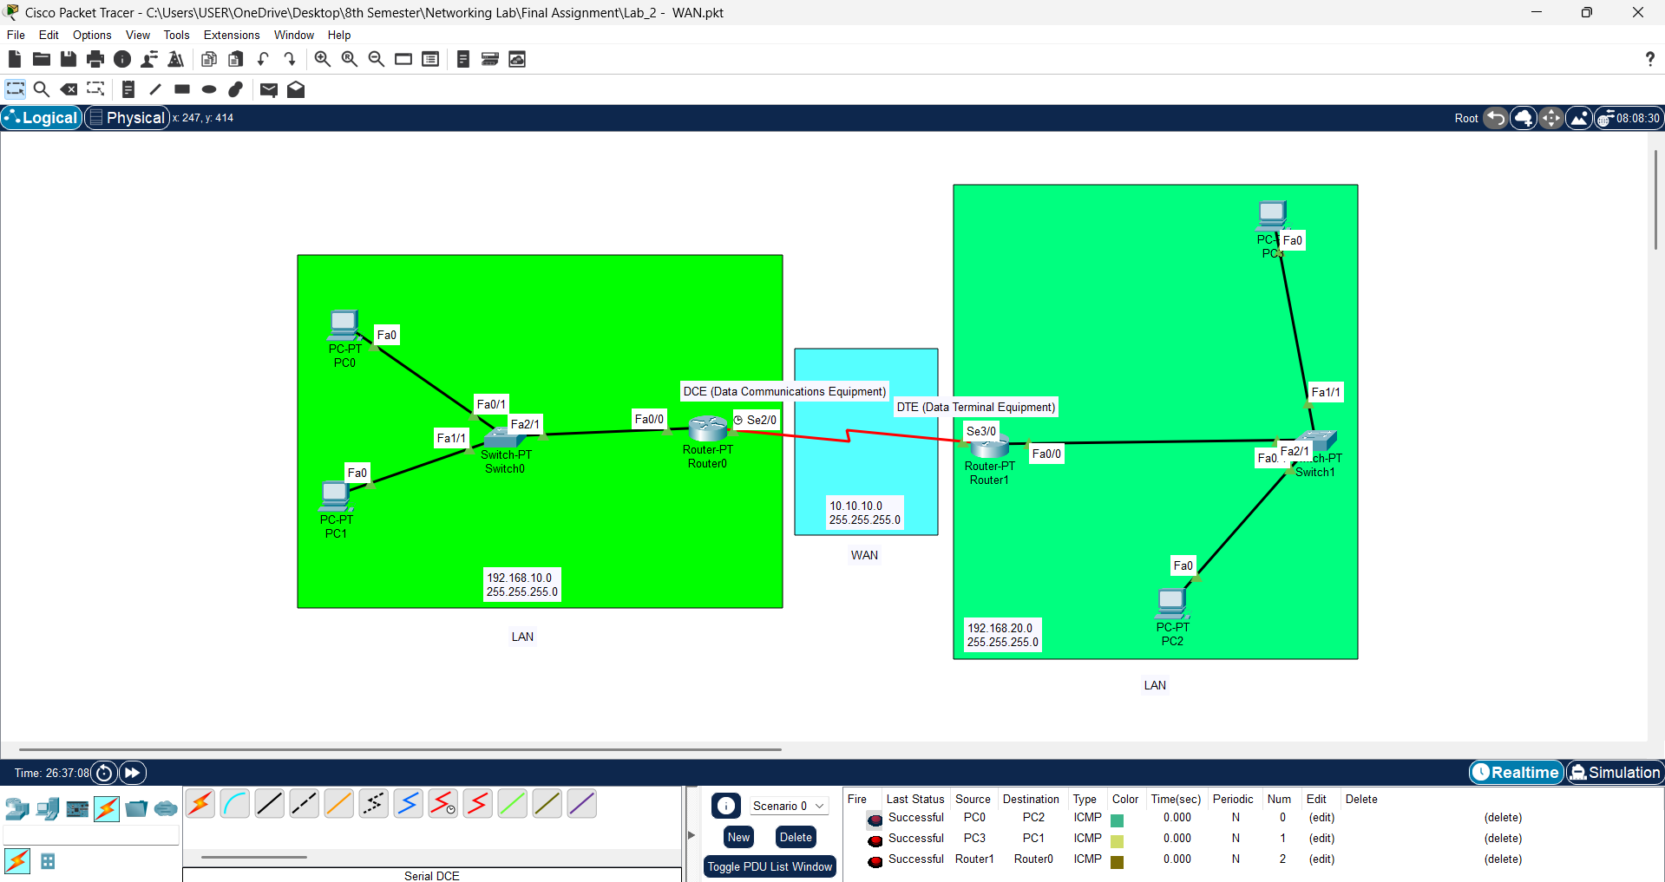
Lab 2 - WAN

Slide 5
Router0
Router1
Router Configuration
Router Configuration
Router>enable
Router#configure terminal
Router(config)#interface fa0/0
Router(config-if)#ip address 192.168.10.1 255.255.255.0
Router(config-if)#no shutdown
Router>enable
Router#configure terminal
Router(config)#interface fa0/0
Router(config-if)#ip address 192.168.20.1 255.255.255.0
Router(config-if)#no shutdown
Router Configuration (Serial)
Router Configuration (Serial)
Router>enable
Router#configure terminal
Router(config)#interface se2/0
Router(config-if)#ip address 10.10.10.1 255.255.255.0
Router(config-if)#clock rate 64000
Router(config-if)#no shutdown
Router>enable
Router#configure terminal
Router(config)#interface se3/0
Router(config-if)#ip address 10.10.10.2 255.255.255.0
Router(config-if)#no shutdown
Serial DCE
IP Route Configuration (Router0)
IP Route Configuration (Router1)
Router>enable
Router#configure terminal
Router(config)#ip route 192.168.20.0 255.255.255.0 se2/0
Router>enable
Router#configure terminal
Router(config)#ip route 192.168.10.0 255.255.255.0 se3/0
More
Router>enable
Router#show ip route
Router#show running-config
Router#show startup-config
Router#copy running-config startup-config

Slide 6
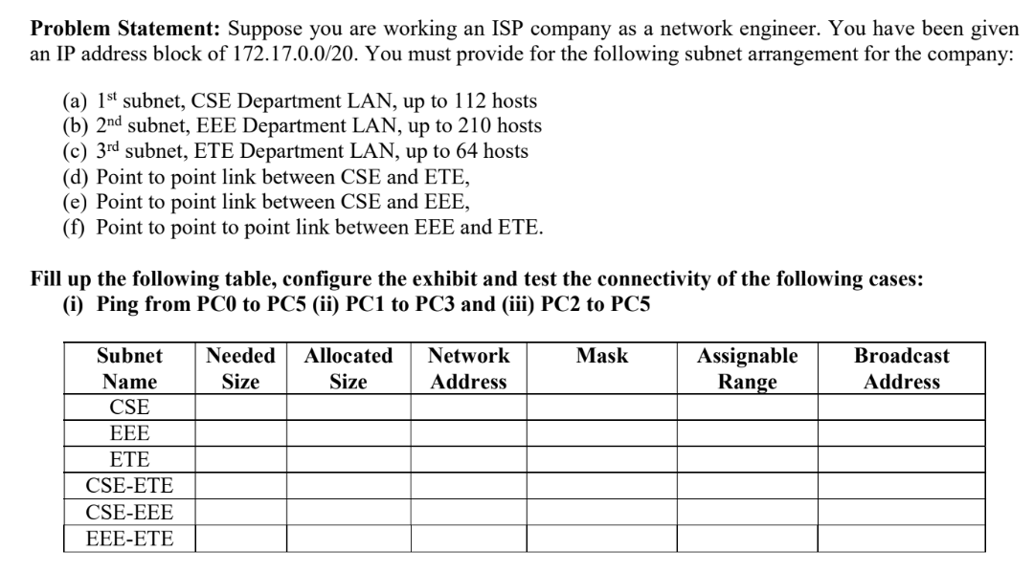
Lab 3 - Subnetting hand calculation
CIDR | Subnet Mask | Hosts (Usable)
/1 | 128.0.0.0 | 2,147,483,646
/2 | 192.0.0.0 | 1,073,741,822
/3 | 224.0.0.0 | 536,870,910
/4 | 240.0.0.0 | 268,435,454
/5 | 248.0.0.0 | 134,217,726
/6 | 252.0.0.0 | 67,108,862
/7 | 254.0.0.0 | 33,554,430
/8 | 255.0.0.0 | 16,777,214
/9 | 255.128.0.0 | 8,388,606
/10 | 255.192.0.0 | 4,194,302
/11 | 255.224.0.0 | 2,097,150
/12 | 255.240.0.0 | 1,048,574
/13 | 255.248.0.0 | 524,286
/14 | 255.252.0.0 | 262,142
/15 | 255.254.0.0 | 131,070
/16 | 255.255.0.0 | 65,534
/17 | 255.255.128.0 | 32,766
/18 | 255.255.192.0 | 16,382
/19 | 255.255.224.0 | 8,190
/20 | 255.255.240.0 | 4,094
/21 | 255.255.248.0 | 2,046
/22 | 255.255.252.0 | 1,022
/23 | 255.255.254.0 | 510
/24 | 255.255.255.0 | 254
/25 | 255.255.255.128 | 126
/26 | 255.255.255.192 | 62
/27 | 255.255.255.224 | 30
/28 | 255.255.255.240 | 14
/29 | 255.255.255.248 | 6
/30 | 255.255.255.252 | 2
/31 | 255.255.255.254 | 0*
/32 | 255.255.255.255 | 0

Slide 7
Solution of the problem: 172.17.0.0 / 20
Step 1: Sort (Descending order) the number of subnets according to their requirement
1st -- subnet, EEE Department LAN => 210 + 2 = 212 - (2⁸) /24
2nd -- subnet, CSE Department LAN => 112 + 2 = 114 - (2⁷) /25
3rd -- subnet, ETE Department LAN => 64 + 2 = 66 - (2⁷) /25
Step 2: Step 3: 212 <= 2^{N}
4th -- Point to point link between CSE and ETE => 2 + 2 = 4 - (2²) /30
5th -- Point to point link between CSE and EEE => 2 + 2 = 4 - (2²) /30
6th -- Point to point link between EEE and ETE => 2 + 2 = 4 - (2²) /30
128 | 64 | 32 | 16 | 8 | 4 | 2 | 1 | 128 | 64 | 32 | 16 | 8 | 4 | 2 | 1 | 128 | 64 | 32 | 16 | 8 | 4 | 2 | 1 | 128 | 64 | 32 | 16 | 8 | 4 | 2 | 1
1 | 0 | 1 | 0 | 1 | 1 | 0 | 0 | 0 | 0 | 0 | 1 | 0 | 0 | 0 | 1 | 0 | 0 | 0 | 0 | 0 | 0 | 0 | 0 | 0 | 0 | 0 | 0 | 0 | 0 | 0 | 0 | Network EEE | 172.17.0.0 / 24
1 | 0 | 1 | 0 | 1 | 1 | 0 | 0 | 0 | 0 | 0 | 1 | 0 | 0 | 0 | 1 | 0 | 0 | 0 | 0 | 0 | 0 | 0 | 0 | 0 | 0 | 0 | 0 | 0 | 0 | 0 | 1 | 1st Host of EEE | 172.17.0.1 / 24
1 | 0 | 1 | 0 | 1 | 1 | 0 | 0 | 0 | 0 | 0 | 1 | 0 | 0 | 0 | 1 | 0 | 0 | 0 | 0 | 0 | 0 | 0 | 0 | 1 | 1 | 1 | 1 | 1 | 1 | 1 | 0 | Last Host of EEE | 172.17.0.254 / 24
1 | 0 | 1 | 0 | 1 | 1 | 0 | 0 | 0 | 0 | 0 | 1 | 0 | 0 | 0 | 1 | 0 | 0 | 0 | 0 | 0 | 0 | 0 | 0 | 1 | 1 | 1 | 1 | 1 | 1 | 1 | 1 | Broadcast EEE | 172.17.0.255 / 24
1 | 0 | 1 | 0 | 1 | 1 | 0 | 0 | 0 | 0 | 0 | 1 | 0 | 0 | 0 | 1 | 0 | 0 | 0 | 0 | 0 | 0 | 0 | 1 | 0 | 0 | 0 | 0 | 0 | 0 | 0 | 0 | Network CSE | 172.17.1.0 / 25
1 | 0 | 1 | 0 | 1 | 1 | 0 | 0 | 0 | 0 | 0 | 1 | 0 | 0 | 0 | 1 | 0 | 0 | 0 | 0 | 0 | 0 | 0 | 1 | 0 | 0 | 0 | 0 | 0 | 0 | 0 | 1 | 1st Host of CSE | 172.17.1.1 / 25
1 | 0 | 1 | 0 | 1 | 1 | 0 | 0 | 0 | 0 | 0 | 1 | 0 | 0 | 0 | 1 | 0 | 0 | 0 | 0 | 0 | 0 | 0 | 1 | 0 | 1 | 1 | 1 | 1 | 1 | 1 | 0 | Last Host of CSE | 172.17.1.126 / 25
1 | 0 | 1 | 0 | 1 | 1 | 0 | 0 | 0 | 0 | 0 | 1 | 0 | 0 | 0 | 1 | 0 | 0 | 0 | 0 | 0 | 0 | 0 | 1 | 0 | 1 | 1 | 1 | 1 | 1 | 1 | 1 | Broadcast CSE | 172.17.1.127 / 25
1 | 0 | 1 | 0 | 1 | 1 | 0 | 0 | 0 | 0 | 0 | 1 | 0 | 0 | 0 | 1 | 0 | 0 | 0 | 0 | 0 | 0 | 0 | 1 | 1 | 0 | 0 | 0 | 0 | 0 | 0 | 0 | Network ETE | 172.17.1.128 / 25
1 | 0 | 1 | 0 | 1 | 1 | 0 | 0 | 0 | 0 | 0 | 1 | 0 | 0 | 0 | 1 | 0 | 0 | 0 | 0 | 0 | 0 | 0 | 1 | 1 | 0 | 0 | 0 | 0 | 0 | 0 | 1 | 1st Host of ETE | 172.17.1.129 / 25
1 | 0 | 1 | 0 | 1 | 1 | 0 | 0 | 0 | 0 | 0 | 1 | 0 | 0 | 0 | 1 | 0 | 0 | 0 | 0 | 0 | 0 | 0 | 1 | 1 | 1 | 1 | 1 | 1 | 1 | 1 | 0 | Last Host of ETE | 172.17.1.254 / 25
1 | 0 | 1 | 0 | 1 | 1 | 0 | 0 | 0 | 0 | 0 | 1 | 0 | 0 | 0 | 1 | 0 | 0 | 0 | 0 | 0 | 0 | 0 | 1 | 1 | 1 | 1 | 1 | 1 | 1 | 1 | 1 | Broadcast ETE | 172.17.1.255 / 25
1 | 0 | 1 | 0 | 1 | 1 | 0 | 0 | 0 | 0 | 0 | 1 | 0 | 0 | 0 | 1 | 0 | 0 | 0 | 0 | 0 | 0 | 1 | 0 | 0 | 0 | 0 | 0 | 0 | 0 | 0 | 0 | Network CSE-ETE | 172.17.2.0 / 30
1 | 0 | 1 | 0 | 1 | 1 | 0 | 0 | 0 | 0 | 0 | 1 | 0 | 0 | 0 | 1 | 0 | 0 | 0 | 0 | 0 | 0 | 1 | 0 | 0 | 0 | 0 | 0 | 0 | 0 | 0 | 1 | 1st Host of CSE-ETE | 172.17.2.1 / 30
1 | 0 | 1 | 0 | 1 | 1 | 0 | 0 | 0 | 0 | 0 | 1 | 0 | 0 | 0 | 1 | 0 | 0 | 0 | 0 | 0 | 0 | 1 | 0 | 0 | 0 | 0 | 0 | 0 | 0 | 1 | 0 | Last Host of CSE-ETE | 172.17.2.2 / 30
1 | 0 | 1 | 0 | 1 | 1 | 0 | 0 | 0 | 0 | 0 | 1 | 0 | 0 | 0 | 1 | 0 | 0 | 0 | 0 | 0 | 0 | 1 | 0 | 0 | 0 | 0 | 0 | 0 | 0 | 1 | 1 | Broadcast CSE-ETE | 172.17.2.3 / 30
1 | 0 | 1 | 0 | 1 | 1 | 0 | 0 | 0 | 0 | 0 | 1 | 0 | 0 | 0 | 1 | 0 | 0 | 0 | 0 | 0 | 0 | 1 | 0 | 0 | 0 | 0 | 0 | 0 | 1 | 0 | 0 | Network CSE-EEE | 172.17.2.4 / 30
1 | 0 | 1 | 0 | 1 | 1 | 0 | 0 | 0 | 0 | 0 | 1 | 0 | 0 | 0 | 1 | 0 | 0 | 0 | 0 | 0 | 0 | 1 | 0 | 0 | 0 | 0 | 0 | 0 | 1 | 0 | 1 | 1st Host of CSE-EEE | 172.17.2.5 / 30
1 | 0 | 1 | 0 | 1 | 1 | 0 | 0 | 0 | 0 | 0 | 1 | 0 | 0 | 0 | 1 | 0 | 0 | 0 | 0 | 0 | 0 | 1 | 0 | 0 | 0 | 0 | 0 | 0 | 1 | 1 | 0 | Last Host of CSE-EEE | 172.17.2.6 / 30
1 | 0 | 1 | 0 | 1 | 1 | 0 | 0 | 0 | 0 | 0 | 1 | 0 | 0 | 0 | 1 | 0 | 0 | 0 | 0 | 0 | 0 | 1 | 0 | 0 | 0 | 0 | 0 | 0 | 1 | 1 | 1 | Broadcast CSE-EEE | 172.17.2.7 / 30
1 | 0 | 1 | 0 | 1 | 1 | 0 | 0 | 0 | 0 | 0 | 1 | 0 | 0 | 0 | 1 | 0 | 0 | 0 | 0 | 0 | 0 | 1 | 0 | 0 | 0 | 0 | 0 | 1 | 0 | 0 | 0 | Network EEE-ETE | 172.17.2.8 / 30
1 | 0 | 1 | 0 | 1 | 1 | 0 | 0 | 0 | 0 | 0 | 1 | 0 | 0 | 0 | 1 | 0 | 0 | 0 | 0 | 0 | 0 | 1 | 0 | 0 | 0 | 0 | 0 | 1 | 0 | 0 | 1 | 1st Host of EEE-ETE | 172.17.2.9 / 30
1 | 0 | 1 | 0 | 1 | 1 | 0 | 0 | 0 | 0 | 0 | 1 | 0 | 0 | 0 | 1 | 0 | 0 | 0 | 0 | 0 | 0 | 1 | 0 | 0 | 0 | 0 | 0 | 1 | 0 | 1 | 0 | Last Host of EEE-ETE | 172.17.2.10 / 30
1 | 0 | 1 | 0 | 1 | 1 | 0 | 0 | 0 | 0 | 0 | 1 | 0 | 0 | 0 | 1 | 0 | 0 | 0 | 0 | 0 | 0 | 1 | 0 | 0 | 0 | 0 | 0 | 1 | 0 | 1 | 1 | Broadcast EEE-ETE | 172.17.2.11 / 30

Slide 8
Subnet Name | Needed Size | Allocated Size | Network Address | Mask | Assignable Range | Broadcast Address
EEE | 210 | 254 | 172.17.0.0 / 24 | 255.255.255.0 | 172.17.0.1 - 172.17.0.254 | 172.17.0.255
CSE | 112 | 126 | 172.17.1.0 / 25 | 255.255.255.128 | 172.17.1.1 - 172.17.1.126 | 172.17.1.127
ETE | 64 | 126 | 172.17.1.128 / 25 | 255.255.255.128 | 172.17.1.129 - 172.17.1.254 | 172.17.1.255
CSE-ETE | 2 | 2 | 172.17.2.0 / 30 | 255.255.255.252 | 172.17.2.1 - 172.17.2.2 | 172.17.2.3
CSE-EEE | 2 | 2 | 172.17.2.4 / 30 | 255.255.255.252 | 172.17.2.5 - 172.17.2.6 | 172.17.2.7
EEE-ETE | 2 | 2 | 172.17.2.8 / 30 | 255.255.255.252 | 172.17.2.9 - 172.17.2.10 | 172.17.2.11

Slide 9
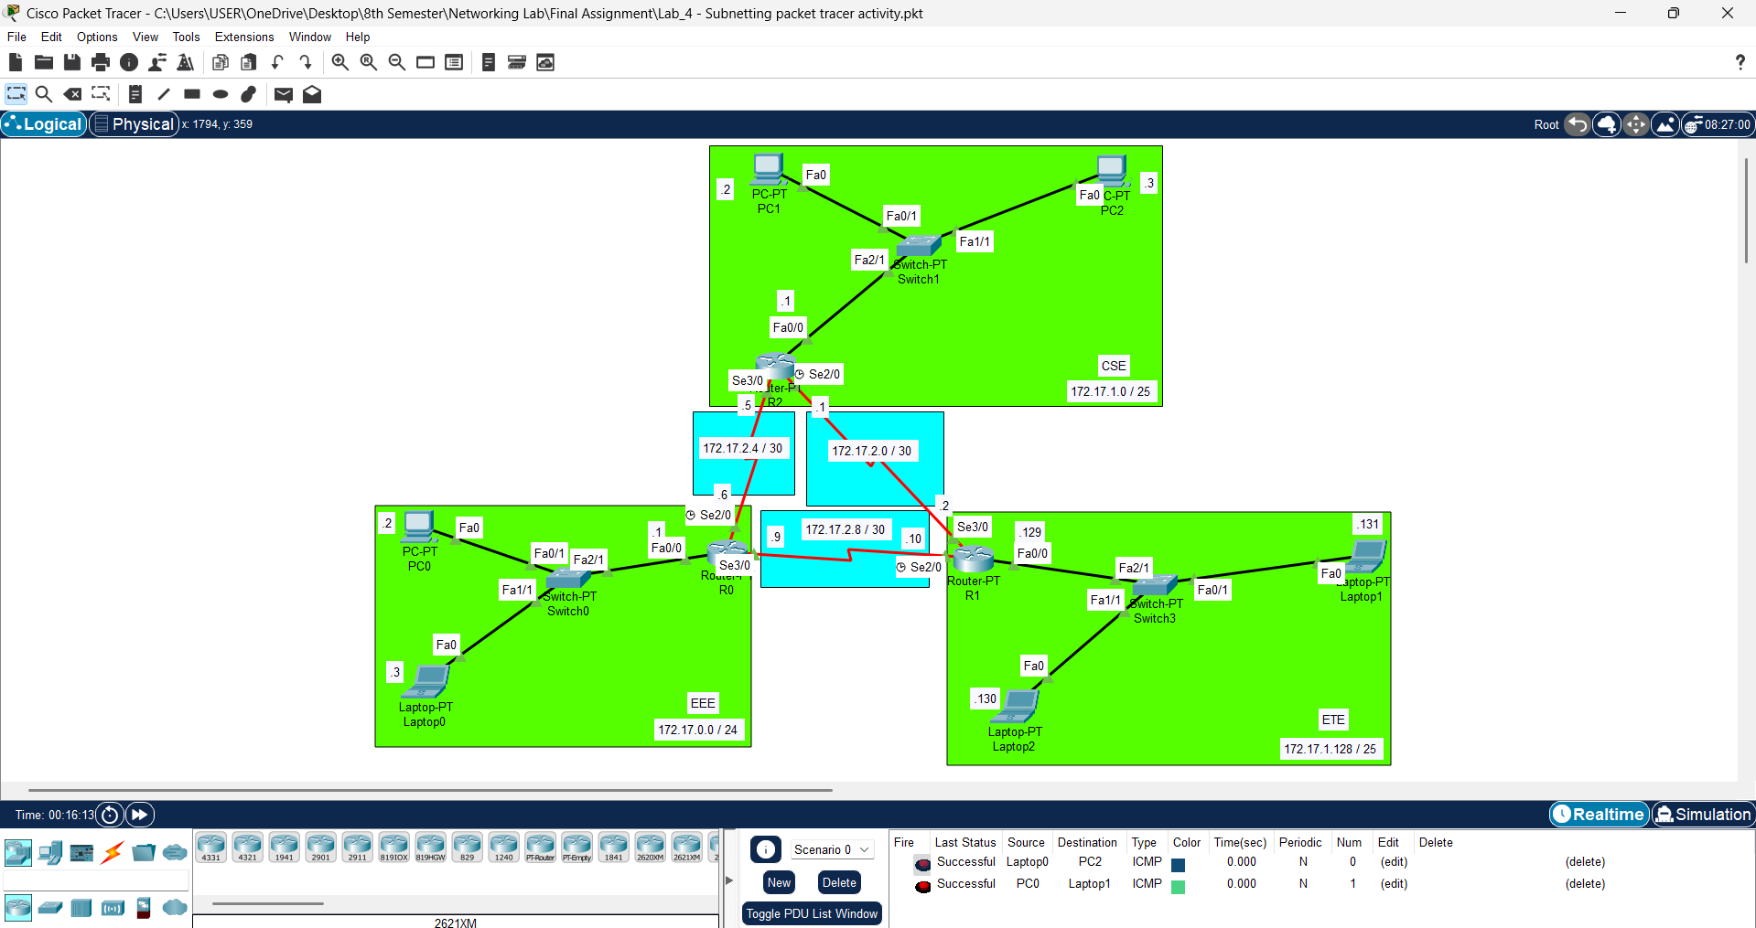
Lab 4 - Subnetting packet tracer activity

Slide 10
Router-PT R0 (EEE)
Router-PT R2 (CSE)
Router-PT R1 (ETE)
Router Configuration
Router Configuration
Router Configuration
Router>enable
Router#configure terminal
Router(config)#interface fa0/0
Router(config-if)#ip address 172.17.0.1 255.255.255.0
Router(config-if)#no shutdown
Router>enable
Router#configure terminal
Router(config)#interface fa0/0
Router(config-if)#ip address 172.17.1.1 255.255.255.0
Router(config-if)#no shutdown
Router>enable
Router#configure terminal
Router(config)#interface fa0/0
Router(config-if)#ip address 172.17.1.129 255.255.255.0
Router(config-if)#no shutdown
Router Configuration (Serial se2/0)
Router Configuration (Serial se2/0)
Router Configuration (Serial se2/0)
Router(config)#interface se2/0
Router(config-if)#ip address 172.17.2.6 255.255.255.252
Router(config-if)#clock rate 64000
Router(config-if)#no shutdown
Router(config-if)#exit
Router(config)#interface se2/0
Router(config-if)#ip address 172.17.2.1 255.255.255.252
Router(config-if)#clock rate 64000
Router(config-if)#no shutdown
Router(config-if)#exit
Router(config)#interface se2/0
Router(config-if)#ip address 172.17.2.10 255.255.255.252
Router(config-if)#clock rate 64000
Router(config-if)#no shutdown
Router(config-if)#exit
Serial DCE
Serial DCE
Serial DCE
Router Configuration (Serial se3/0)
Router Configuration (Serial se3/0)
Router Configuration (Serial se3/0)
Router(config)#interface se3/0
Router(config-if)#ip address 172.17.2.9 255.255.255.252
Router(config-if)#no shutdown
Router(config)#interface se3/0
Router(config-if)#ip address 172.17.2.5 255.255.255.252
Router(config-if)#no shutdown
Router(config)#interface se3/0
Router(config-if)#ip address 172.17.2.2 255.255.255.252
Router(config-if)#no shutdown
IP Route Configuration
IP Route Configuration
IP Route Configuration
Router(config)#ip route 172.17.1.0 255.255.255.128 se2/0
Router(config)#ip route 172.17.1.128 255.255.255.128 se3/0
Router(config)#ip route 172.17.0.0 255.255.255.0 se2/0
Router(config)#ip route 172.17.1.128 255.255.255.128 se3/0
Router(config)#ip route 172.17.0.0 255.255.255.0 se2/0
Router(config)#ip route 172.17.1.0 255.255.255.128 se3/0

Slide 11
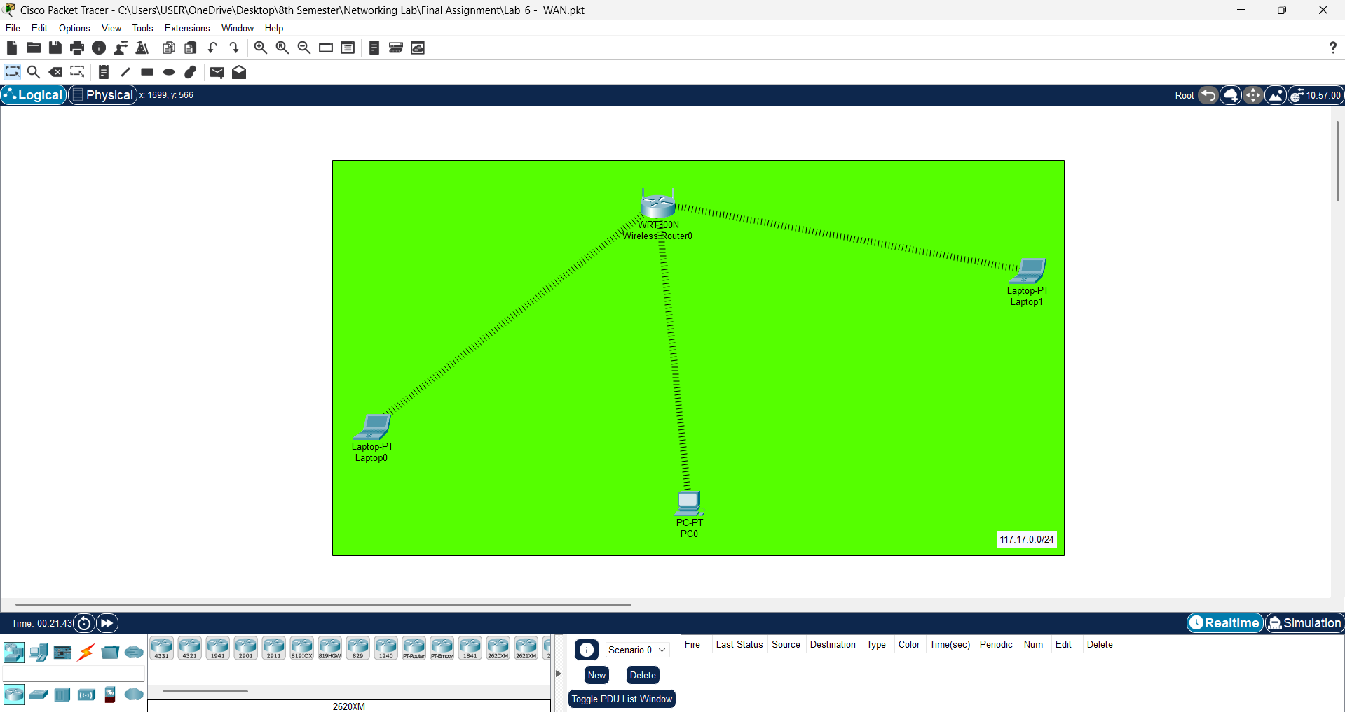
Lab 5 - Wireless LAN (WLAN)

Slide 12
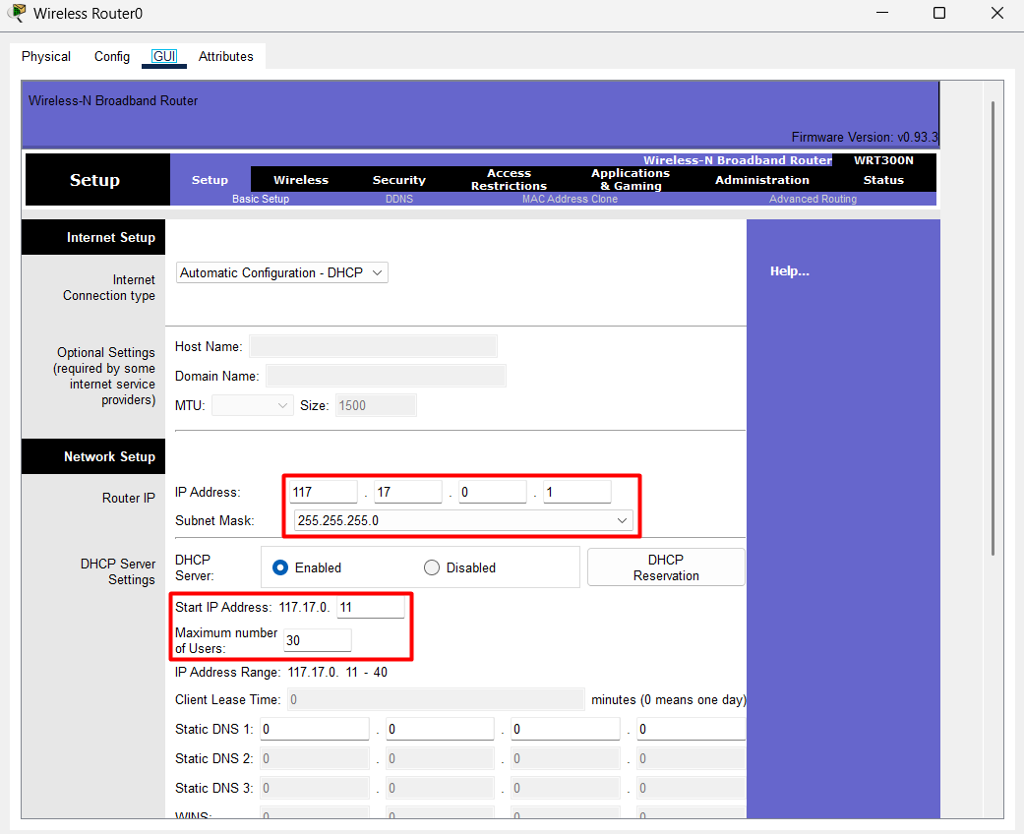
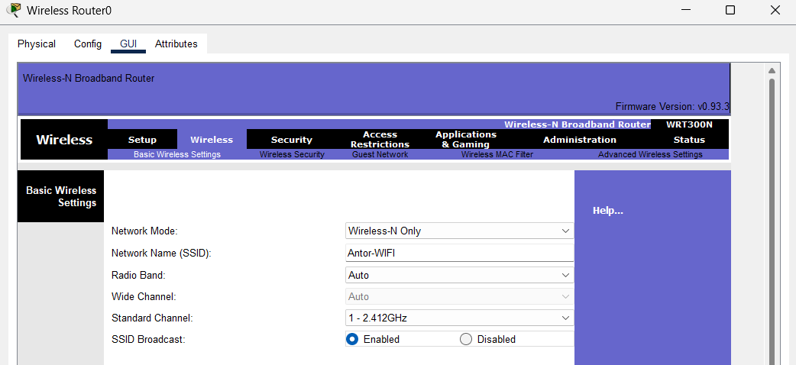
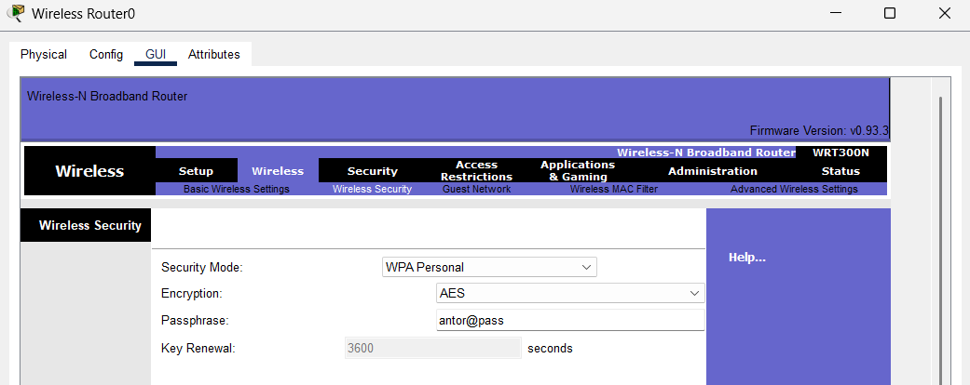

Slide 13
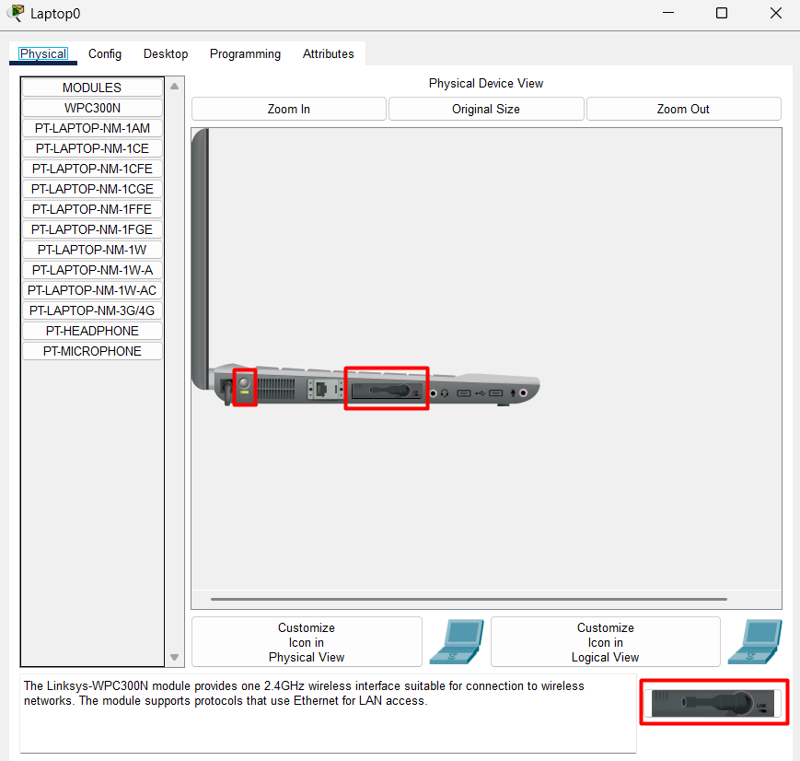
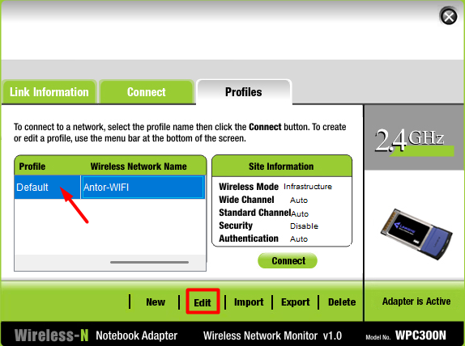
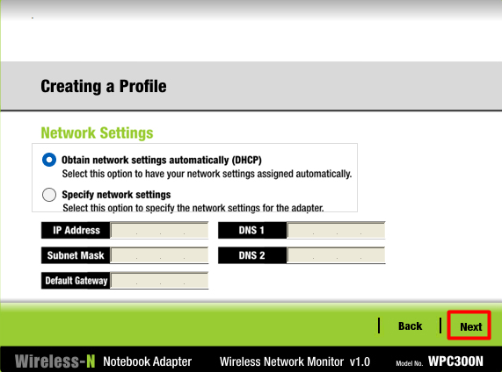
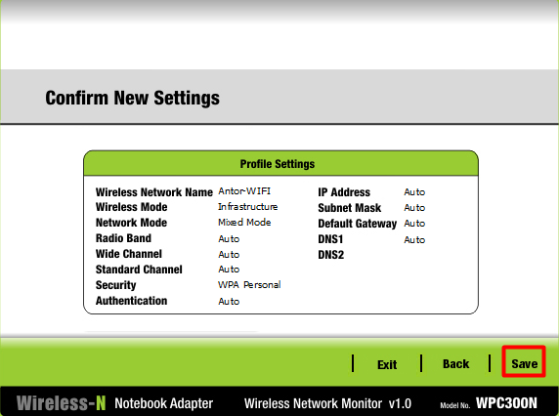
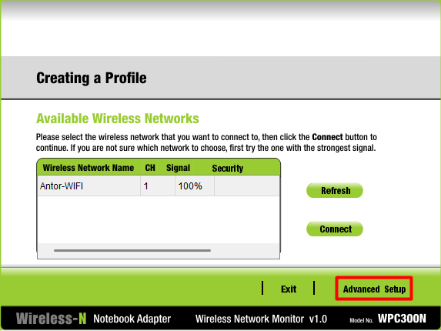
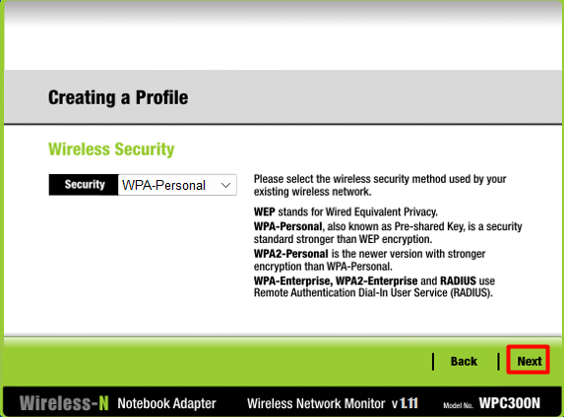
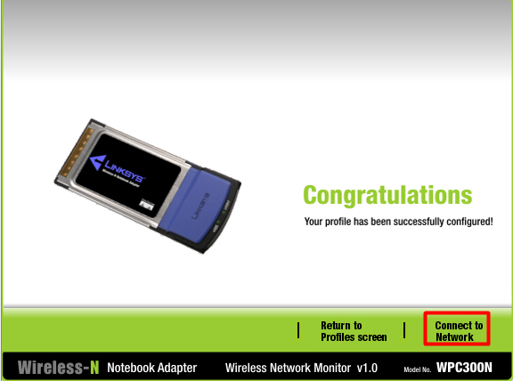
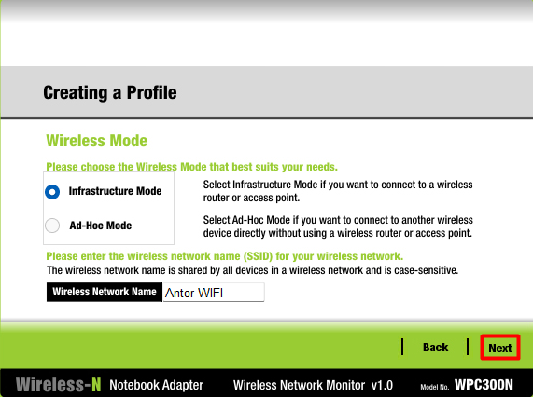
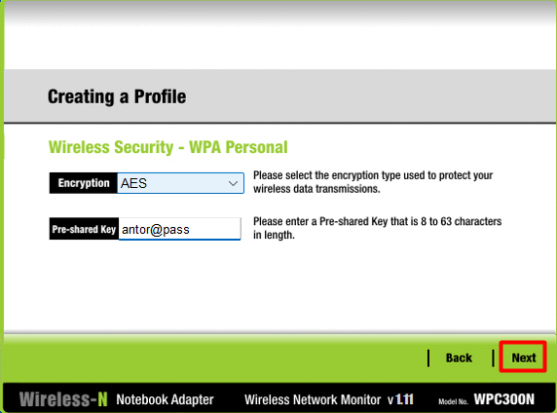
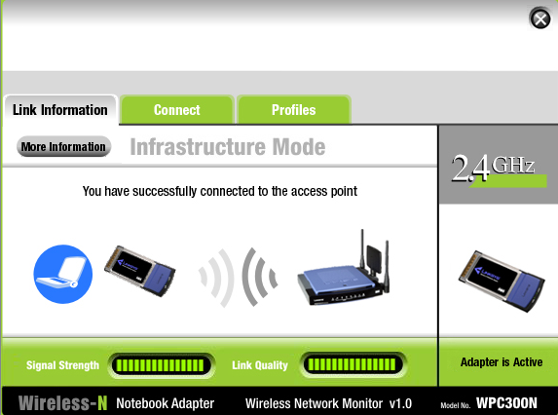

Slide 14
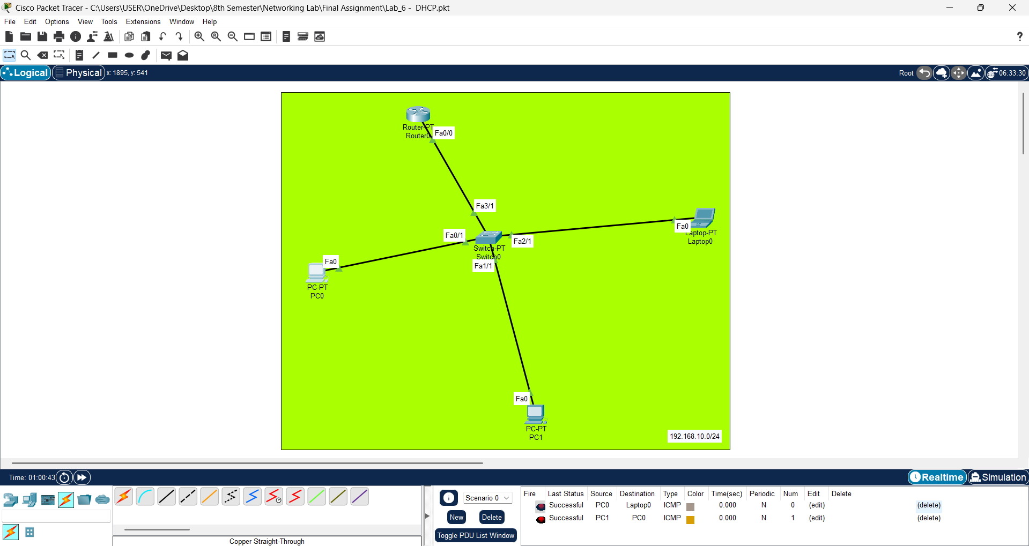
Lab 6 - DHCP

Slide 15
Router0
Router Configuration
Router>enable
Router#configure terminal
Router(config)#interface fa0/0
Router(config-if)#ip address 192.168.10.1 255.255.255.0
Router(config-if)#no shutdown
Router Configuration (DHCP)
Router(config)#ip dhcp excluded-address 192.168.10.1 192.168.10.10
Router(config)#ip dhcp excluded-address 192.168.10.254
Router(config)#ip dhcp pool LAN-POOL-1
Router(dhcp-config)#network 192.168.10.0 255.255.255.0
Router(dhcp-config)#default-router 192.168.10.1
Router#copy running-config startup-config

Slide 16
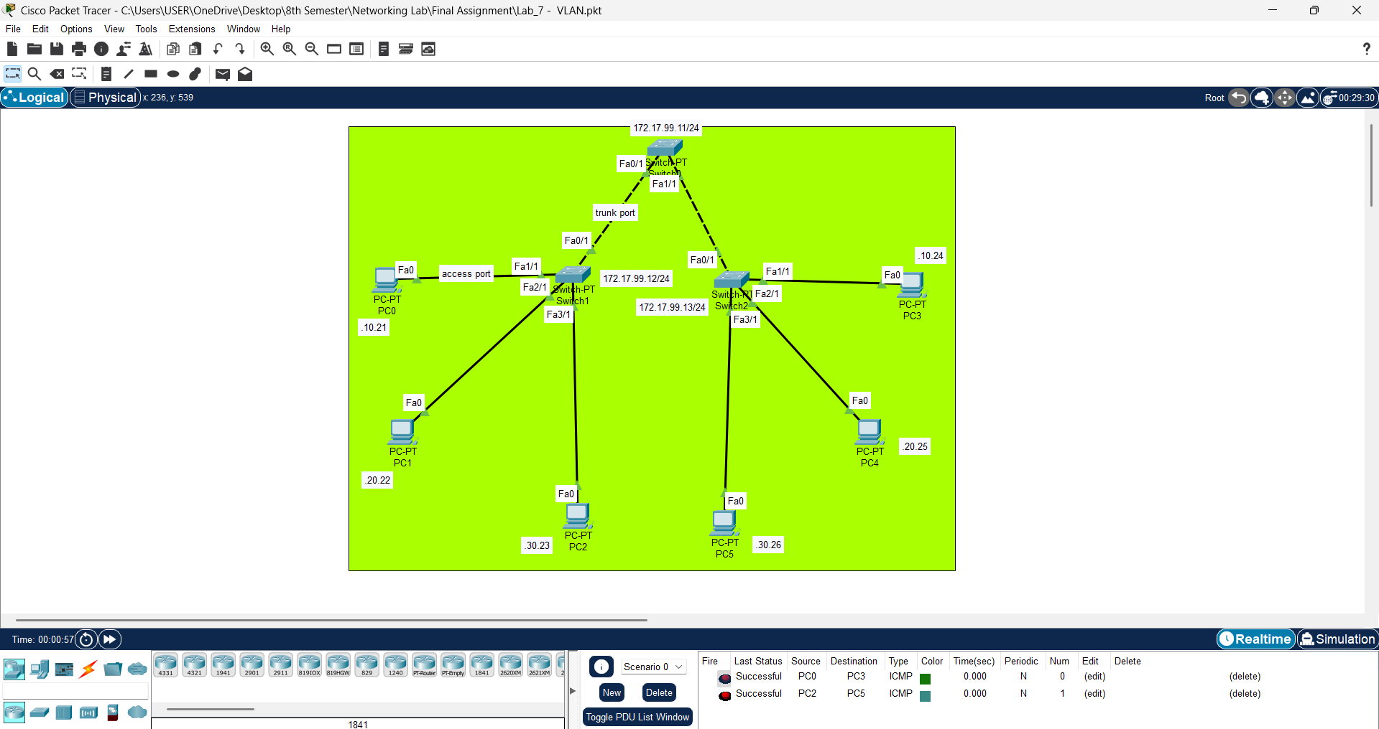
Lab 7 - VLAN

Slide 17
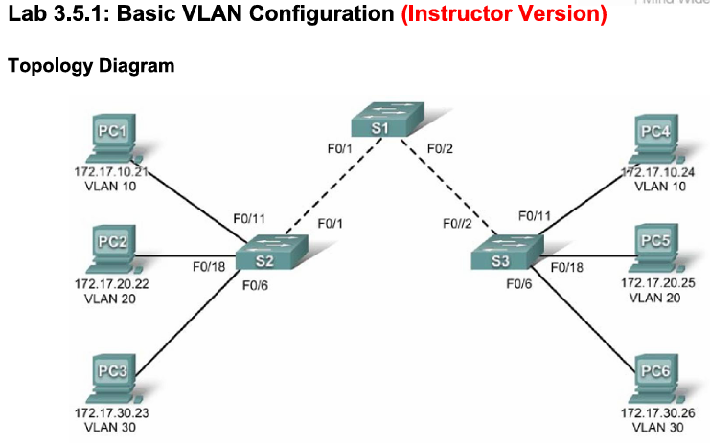
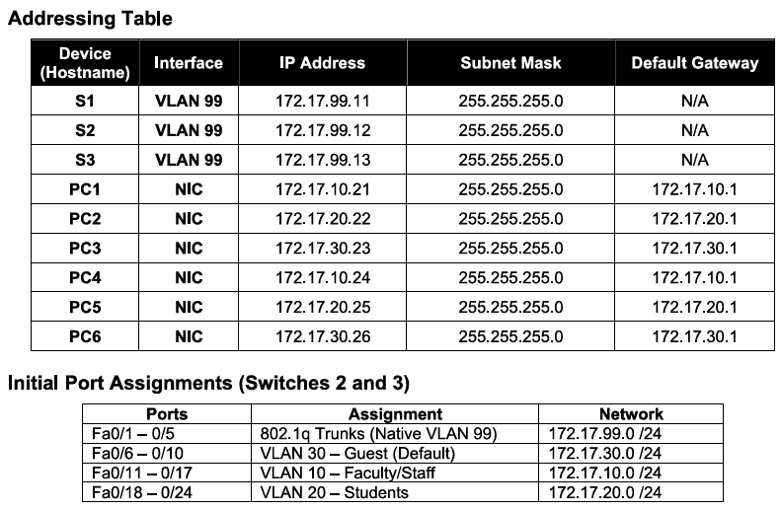
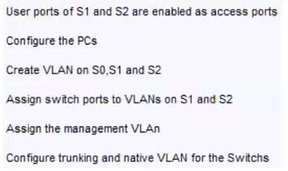

Slide 18
Switch1
Switch2
Switch0
User ports of S1 and S2 are enabled as access ports
User ports of S1 and S2 are enabled as access ports
User ports of S1 and S2 are enabled as access ports
Router>enable
Router#configure terminal
Switch(config)#interface range fa1/1, fa2/1, fa3/1
Switch(config-if)#switchport mode access
Switch(config-if)#no shutdown
Router>enable
Router#configure terminal
Switch(config)#interface range fa1/1, fa2/1, fa3/1
Switch(config-if)#switchport mode access
Switch(config-if)#no shutdown
Router>enable
Router#configure terminal
Configure the PCs with appropriate IP addresses
Configure the PCs with appropriate IP addresses
Configure the PCs with appropriate IP addresses
Create VLANs on S0, S1, and S2
Create VLANs on S0, S1, and S2
Create VLANs on S0, S1, and S2
Switch(config)#vlan 10
Switch(config-vlan)#name faculty
Switch(config)#vlan 20
Switch(config-vlan)#name students
Switch(config)#vlan 30
Switch(config-vlan)#name guest
Switch(config)#vlan 99
Switch(config-vlan)#name management
Switch(config-vlan)#end
Switch(config)#vlan 10
Switch(config-vlan)#name faculty
Switch(config)#vlan 20
Switch(config-vlan)#name students
Switch(config)#vlan 30
Switch(config-vlan)#name guest
Switch(config)#vlan 99
Switch(config-vlan)#name management
Switch(config-vlan)#end
Switch(config)#vlan 10
Switch(config-vlan)#name faculty
Switch(config)#vlan 20
Switch(config-vlan)#name students
Switch(config)#vlan 30
Switch(config-vlan)#name guest
Switch(config)#vlan 99
Switch(config-vlan)#name management
Switch(config-vlan)#end
Assign switch ports to VLANs on S1 and S2
Assign switch ports to VLANs on S1 and S2
Assign switch ports to VLANs on S1 and S2
Switch(config)#interface fa1/1
Switch(config-if)#switchport access vlan 10
Switch(config-if)#no shutdown
Switch(config)#interface fa2/1
Switch(config-if)#switchport access vlan 20
Switch(config-if)#no shutdown
Switch(config)#interface fa3/1
Switch(config-if)#switchport access vlan 30
Switch(config-if)#no shutdown
Switch(config)#interface fa1/1
Switch(config-if)#switchport access vlan 10
Switch(config-if)#no shutdown
Switch(config)#interface fa2/1
Switch(config-if)#switchport access vlan 20
Switch(config-if)#no shutdown
Switch(config)#interface fa3/1
Switch(config-if)#switchport access vlan 30
Switch(config-if)#no shutdown
Assign the management VLAN on all switches
Assign the management VLAN on all switches
Assign the management VLAN on all switches
Switch(config)#interface vlan 99
Switch(config-if)#ip address 117.17.99.12 255.255.255.0
Switch(config-if)#no shutdown
Switch(config)#interface vlan 99
Switch(config-if)#ip address 117.17.99.13 255.255.255.0
Switch(config-if)#no shutdown
Switch(config)#interface vlan 99
Switch(config-if)#ip address 117.17.99.11 255.255.255.0
Switch(config-if)#no shutdown
Configure trunking and native VLAN between the switches
Configure trunking and native VLAN between the switches
Configure trunking and native VLAN between the switches
Switch(config)#interface fa0/1
Switch(config-if)#switchport mode trunk
Switch(config-if)#switchport trunk native vlan 99
Switch(config-if)#no shutdown
Switch(config)#interface fa0/1
Switch(config-if)#switchport mode trunk
Switch(config-if)#switchport trunk native vlan 99
Switch(config-if)#no shutdown
Switch(config)#interface range fa0/1, fa1/1
Switch(config-if)#switchport mode trunk
Switch(config-if)#switchport trunk native vlan 99
Switch(config-if)#no shutdown
More
Switch#show vlan brief

Slide 19
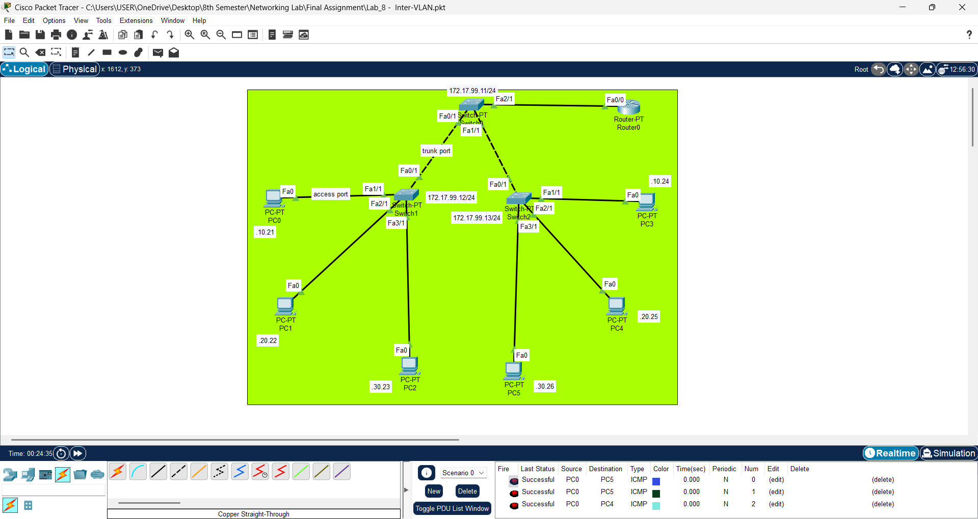
Lab 8 - Inter-VLAN

Slide 20
Router0
Switch0
Router Configuration
Switch Configuration (Inter-VLAN)
Router>enable
Router#configure terminal
Router(config)#interface fa0/0
Router(config-if)#no shutdown
Switch(config)#interface fa2/1
Switch(config-if)#switchport mode trunk
Switch(config-if)#switchport trunk native vlan 99
Switch(config-if)#no shutdown
Router Configuration (Inter-VLAN)
Router(config)#interface fa0/0.10
Router(config-subif)#encapsulation dot1Q 10
Router(config-subif)#ip address 172.17.10.1 255.255.255.0
Router(config-subif)#no shutdown
Router(config)#interface fa0/0.20
Router(config-subif)#encapsulation dot1Q 20
Router(config-subif)#ip address 172.17.20.1 255.255.255.0
Router(config-subif)#no shutdown
Router(config)#interface fa0/0.30
Router(config-subif)#encapsulation dot1Q 30
Router(config-subif)#ip address 172.17.30.1 255.255.255.0
Router(config-subif)#no shutdown
Router(config)#interface fa0/0.99
Router(config-subif)#encapsulation dot1Q 99
Router(config-subif)#ip address 172.17.99.1 255.255.255.0
Router(config-subif)#no shutdown

Slide 21
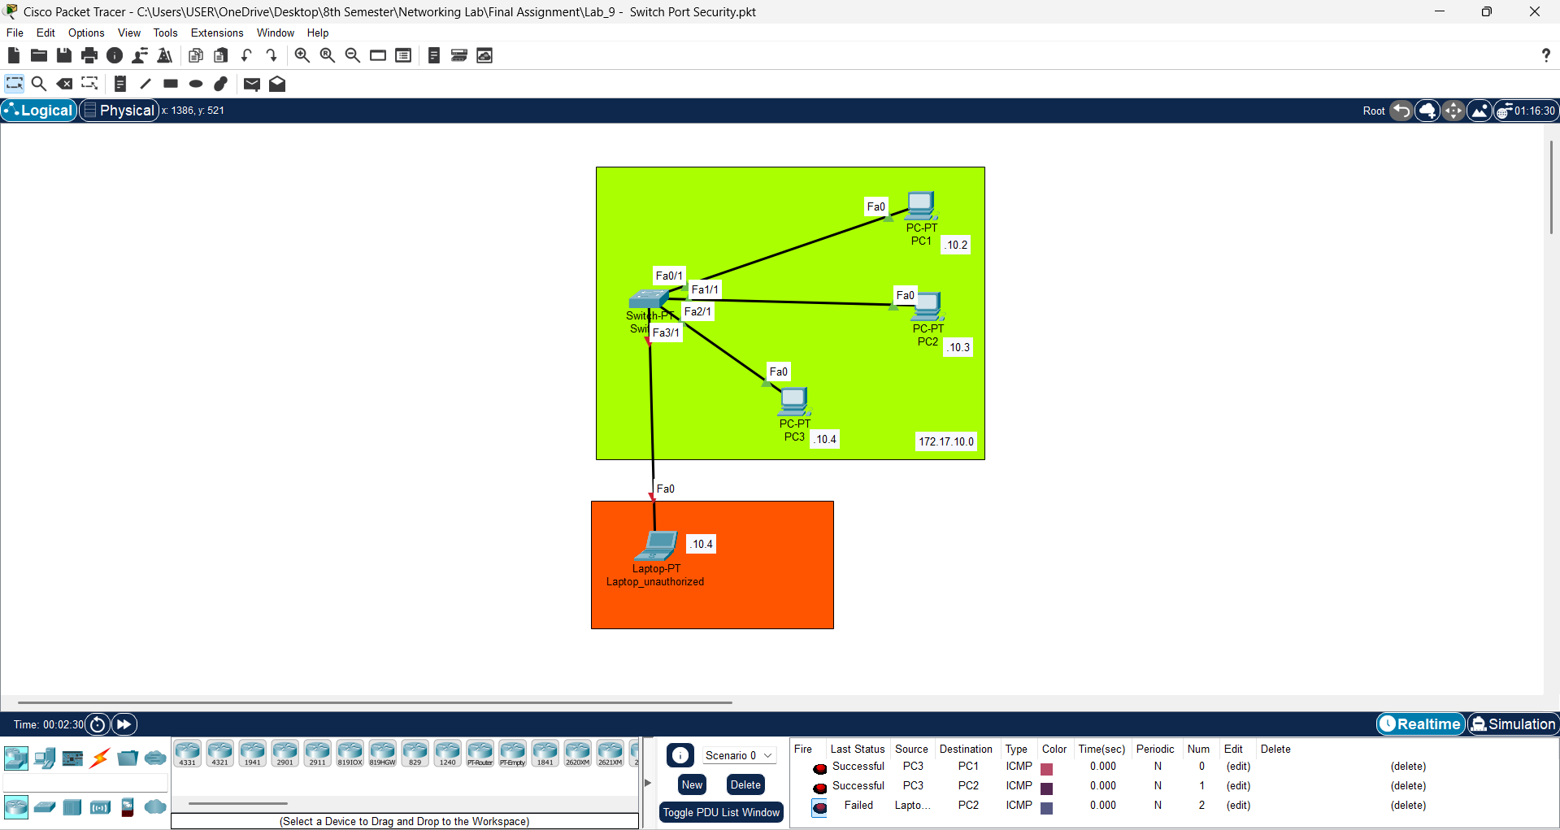
Lab 9 - Switch Port Security

Slide 22
Switch0
Switch Configuration
Switch>enable
Switch#configure terminal
Switch(config)#interface range Fa3/1-Fa5/1
Switch(config-if)#shutdown
Switch Configuration (Port Security)
Switch(config)#interface range Fa0/1, Fa1/1, Fa2/1
Switch(config-if)#switchport mode access
Switch(config-if)#switchport port-security
Switch(config-if)#switchport port-security mac-address sticky
Switch(config-if)#switchport port-security violation shutdown
Switch(config-if)#no shutdown
protect: drop the packet
restrict: drop the packet and count the number of violations
shutdown: drop the packet and shutdown the corresponding link
More
Switch#show port-security
Switch #copy running-config startup-config
Or
Switch #write memory

Slide 23
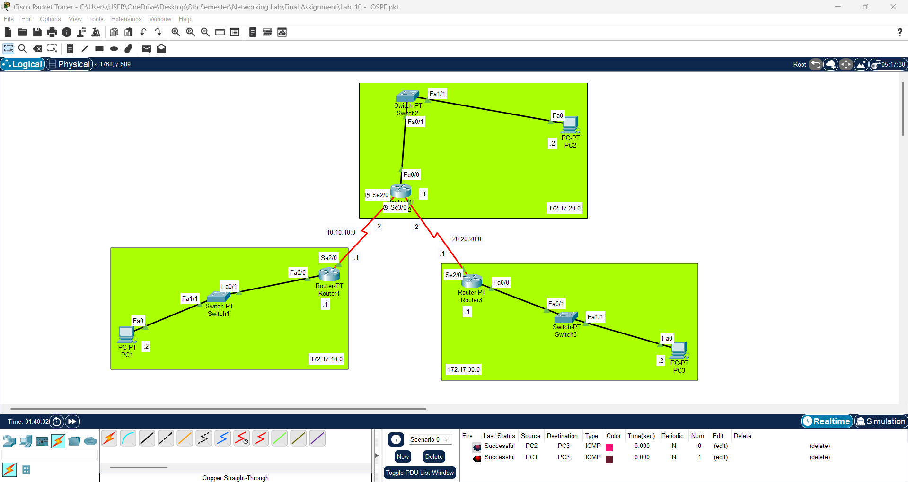
Dynamic routing>
Lab 10 - OSPF (Open Shortest Path First

Slide 24
Router1
Router2
Router3
Router Configuration
Router Configuration
Router Configuration
Router>enable
Router#configure terminal
Router(config)#interface fa0/0
Router(config-if)#ip address 172.17.10.1 255.255.255.0
Router(config-if)#no shutdown
Router>enable
Router#configure terminal
Router(config)#interface fa0/0
Router(config-if)#ip address 172.17.20.1 255.255.255.0
Router(config-if)#no shutdown
Router>enable
Router#configure terminal
Router(config)#interface fa0/0
Router(config-if)#ip address 172.17.30.1 255.255.255.0
Router(config-if)#no shutdown
Router Configuration (se2/0)
Router Configuration (se2/0)
Router Configuration (se2/0)
Router(config)#interface se2/0
Router(config-if)#ip address 10.10.10.1 255.255.255.0
Router(config-if)#no shutdown
Router(config)#interface se2/0
Router(config-if)#ip address 10.10.10.2 255.255.255.0
Router(config-if)#clock rate 64000
Router(config-if)#no shutdown
Router(config)#interface se2/0
Router(config-if)#ip address 20.20.20.1 255.255.255.0
Router(config-if)#no shutdown
Serial DCE
Router OSPF Configuration
Router OSPF Configuration
Router Configuration (se3/0)
Router(config)#router ospf 1
Router(config-router)#network 172.17.10.0 0.0.0.255 area 0
Router(config-router)#network 10.10.10.0 0.0.0.255 area 0
Router(config)#router ospf 1
Router(config-router)#network 172.17.30.0 0.0.0.255 area 0
Router(config-router)#network 20.20.20.0 0.0.0.255 area 0
Router(config)#interface se3/0
Router(config-if)#ip address 20.20.20.2 255.255.255.0
Router(config-if)#clock rate 64000
Router(config-if)#no shutdown
Serial DCE
Router OSPF Configuration
Router(config)#router ospf 1
Router(config-router)#network 172.17.20.0 0.0.0.255 area 0
Router(config-router)#network 10.10.10.0 0.0.0.255 area 0
Router(config-router)#network 20.20.20.0 0.0.0.255 area 0
More
Router#show ip ospf neighbor
Router#show ip route ospf

Slide 25
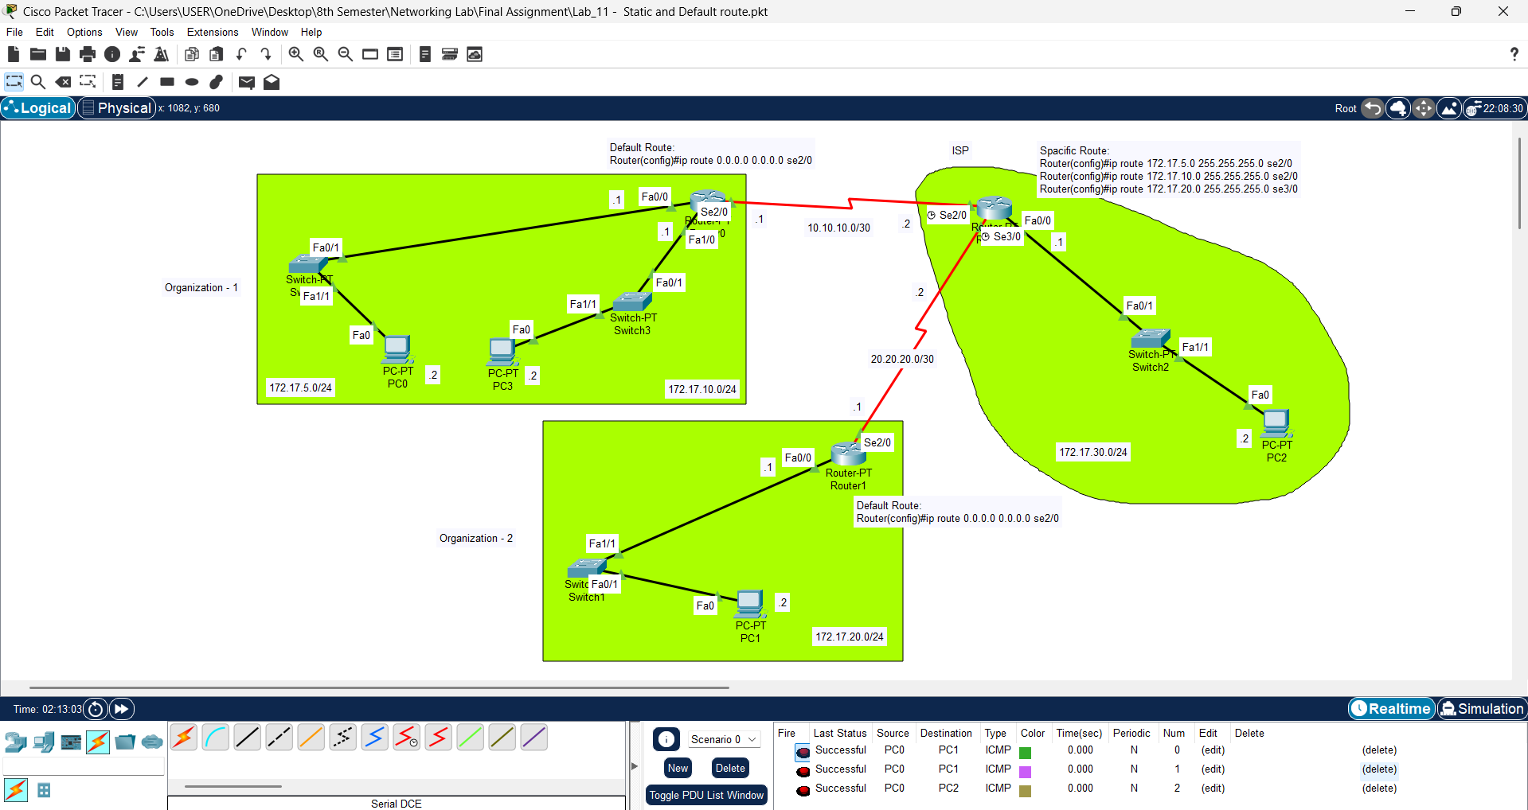
Lab 11 - Static and default route

Slide 26
Router0
Router1
Router2 (ISP)
Router Configuration
Router Configuration
Router Configuration
Router(config)#interface fa0/0
Router(config-if)#ip address 172.17.5.1 255.255.255.0h
Router(config-if)#no shutdown
Router(config)#interface fa1/0
Router(config-if)#ip address 172.17.10.1 255.255.255.0
Router(config-if)#no shutdown
Router(config)#interface se2/0
Router(config-if)#ip address 10.10.10.1 255.255.255.252
Router(config-if)#no shutdown
Router(config)#interface fa0/0
Router(config-if)#ip address 172.17.20.1 255.255.255.0
Router(config-if)#no shutdown
Router(config)#interface se2/0
Router(config-if)#ip address 20.20.20.1 255.255.255.252
Router(config-if)#no shutdown
Router(config)#ip route 0.0.0.0 0.0.0.0 se2/0
Router(config)#interface fa0/0
Router(config-if)#ip address 172.17.30.1 255.255.255.0
Router(config-if)#no shutdown
Router(config)#interface se2/0
Router(config-if)#ip address 10.10.10.2 255.255.255.252
Router(config-if)#clock rate 64000
Router(config-if)#no shutdown
Router(config)#interface se3/0
Router(config-if)#ip address 20.20.20.2 255.255.255.252
Router(config-if)#clock rate 64000
Router(config-if)#no shutdown
Default Route
Default Route
Spacific Route
Router(config)#ip route 0.0.0.0 0.0.0.0 se2/0
Router(config)#ip route 0.0.0.0 0.0.0.0 se2/0
Router(config)#ip route 172.17.5.0 255.255.255.0 se2/0
Router(config)#ip route 172.17.10.0 255.255.255.0 se2/0
Router(config)#ip route 172.17.20.0 255.255.255.0 se3/0
More
Router#show ip route

Slide 27
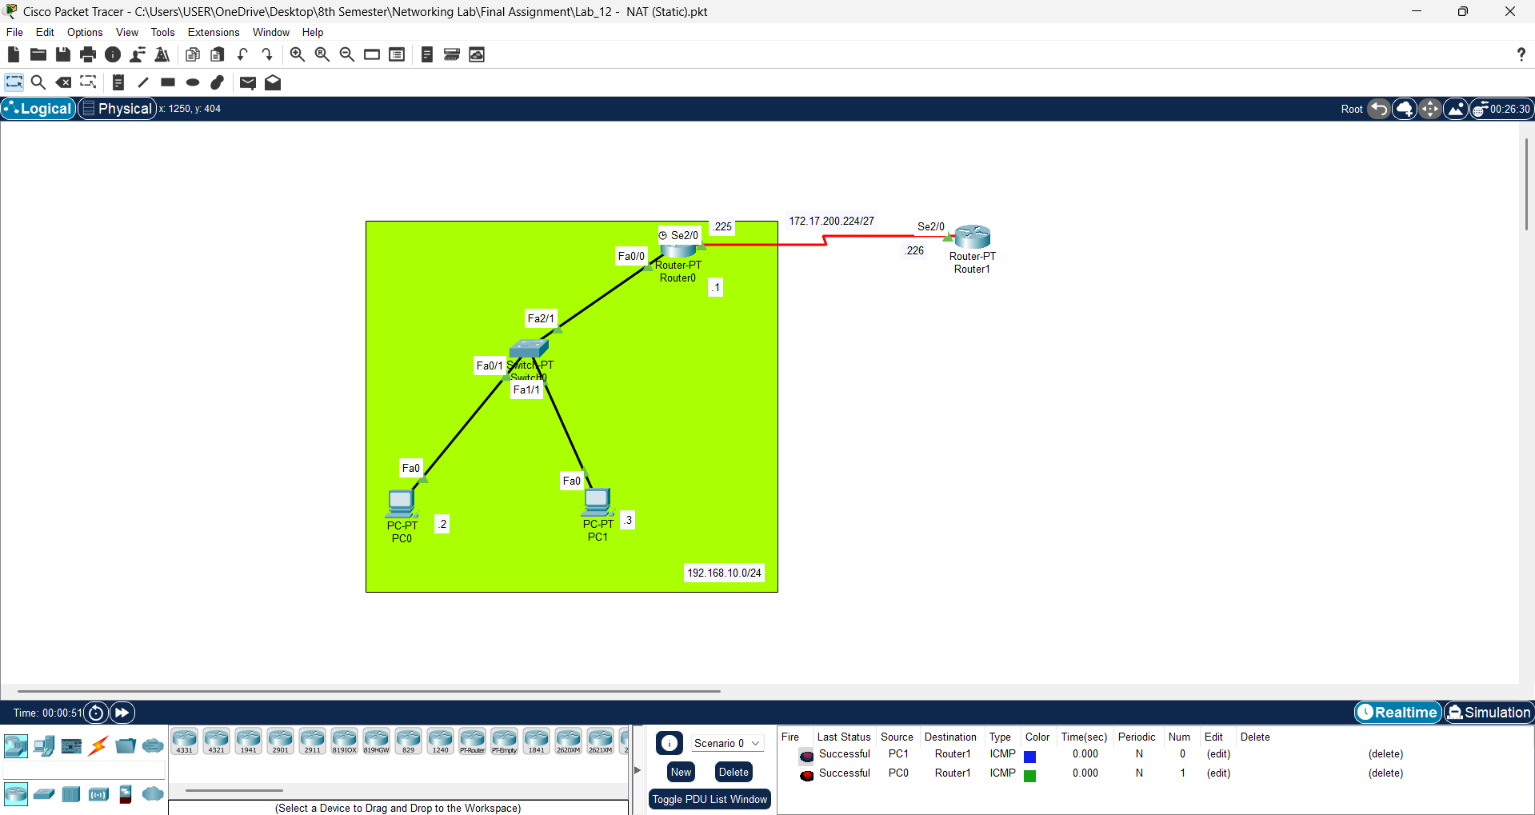
Lab 12 - NAT (Static) – Network Address Translation

Slide 28
Router0
Router1
Router Configuration
Router Configuration
Router(config)#ip route 0.0.0.0 0.0.0.0 se2/0
Router(config)#ip route 192.168.10.0 255.255.255.0 se2/0
Router Configuration (NAT – Static)
Router(config)#ip nat inside source static 192.168. 10. 2 172.17.200.227
Router(config)#ip nat inside source static 192.168. 10. 2 172.17.200.226
Router(config)#interface fa0/0
Router(config)#ip nat inside
Router(config)#no shutdown
Router(config)#interface se2/0
Router(config)#ip nat outside
Router(config)#no shutdown
More
Router#show ip nat statistics
Router#show ip nat translations

Slide 29
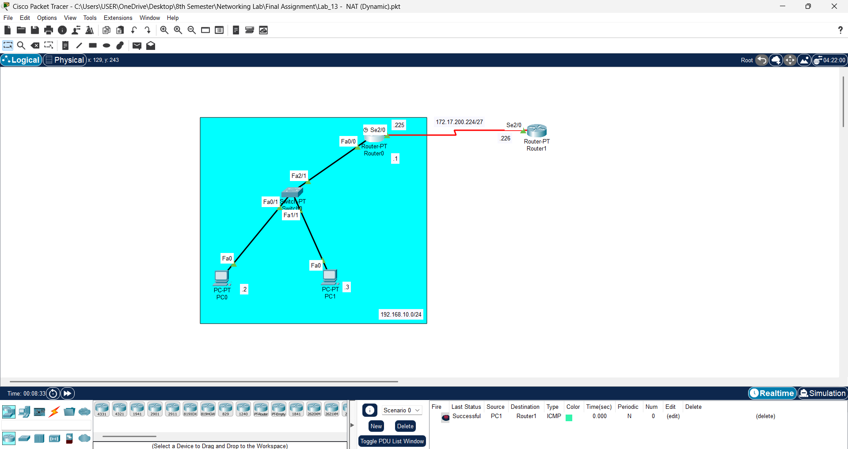
Lab 13 - NAT (Dynamic)

Slide 30
Router0
Router1
Router Configuration
Router Configuration
Router(config)#ip route 0.0.0.0 0.0.0.0 se2/0
Router(config)#ip route 192.168.10.0 255.255.255.0 se2/0
Router Configuration (NAT – Dynamic)
Router(config)#ip nat pool NAT_POOL1 172.17.200.227 172.17.200.235 netmask 255.255.255.224
Router(config)#ip access-list standard ACL1
Router(config-std-nacl)#Permit 192.168.10.0 0.0.0.255
Router(config-std-nacl)#ip nat inside source list ACL1 pool NAT_POOL1 overload
Router(config)#interface fa0/0
Router(config-if)#ip nat inside
Router(config-if)#no shutdown
Router(config)#interface ser2/0
Router(config-if)#ip nat outside
Router(config-if)#no shutdown
More
Router#show ip nat statistics
Router#show ip nat translations

Slide 31
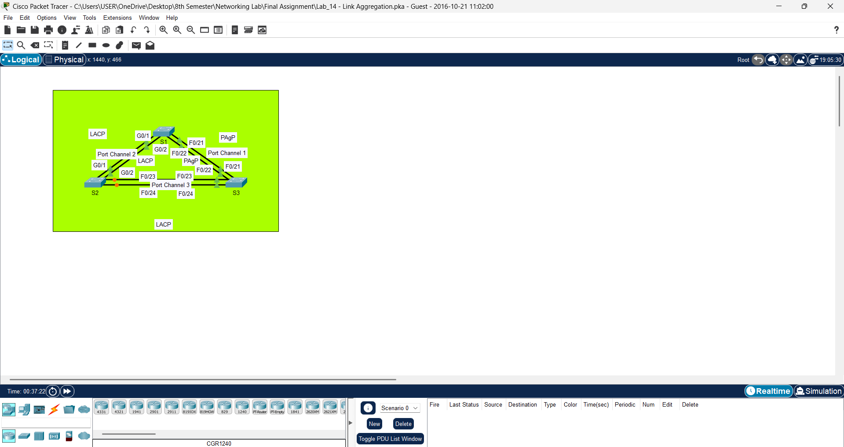
Lab 14 - Link Aggregation

Slide 32
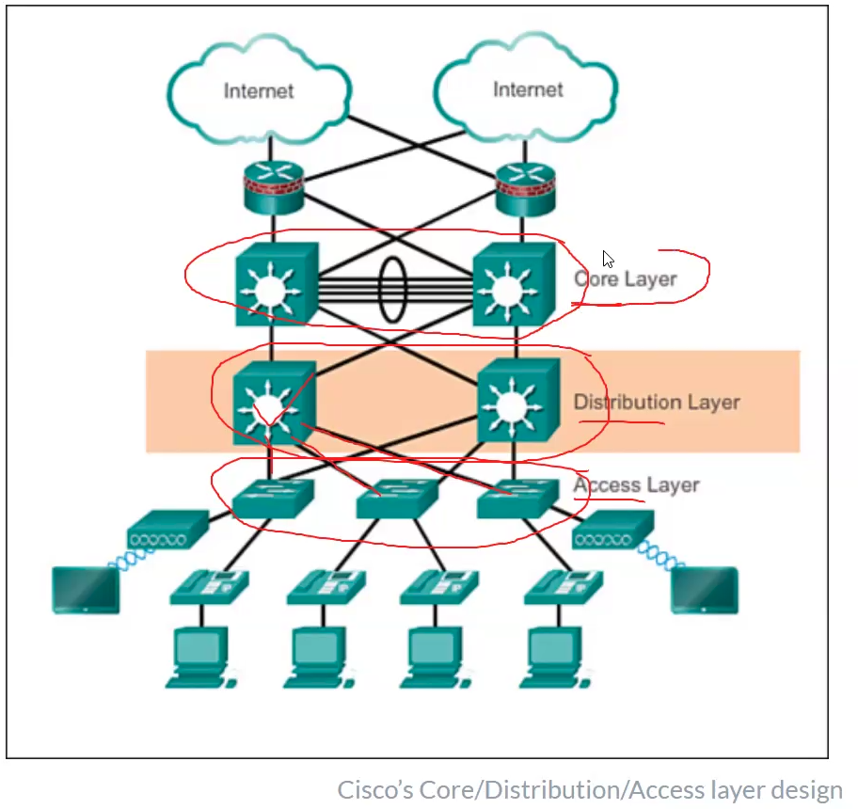
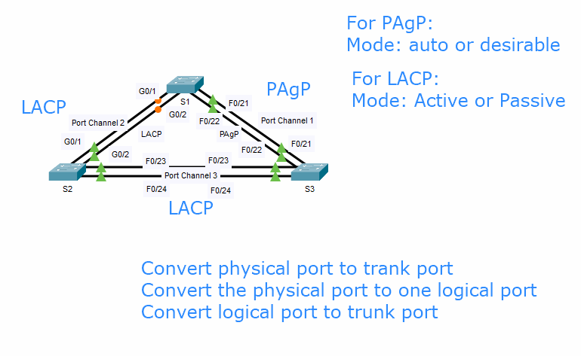
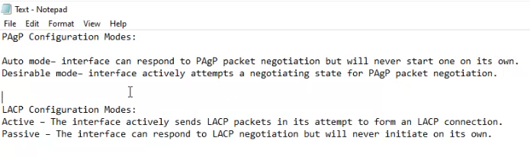

Slide 33
(1) Convert physical port to trank port
S1
S2
S3
Switch(config)#interface range g0/1-2
Switch(config-if-range)#switchport mode trunk
Switch(config-if-range)#no shutdown
Switch(config)#interface range f0/21-22
Switch(config-if-range)#switchport mode trunk
Switch(config-if-range)#no shutdown
Switch(config)#interface range g0/1-2
Switch(config-if-range)#switchport mode trunk
Switch(config-if-range)#no shutdown
Switch(config)#interface range f0/23-24
Switch(config-if-range)#switchport mode trunk
Switch(config-if-range)#no shutdown
Switch(config)#interface range f0/21-24
Switch(config-if-range)#switchport mode trunk
Switch(config-if-range)#no shutdown
(2) Convert the physical port to one logical port
S1 & S3
S1 & S2
S2 & S3
Switch(config)#interface range f0/21 - 22
Switch(config-if-range)#shutdown
Switch(config-if-range)#channel-group 1 mode desirable
Switch(config-if-range)#no shutdown
Switch(config)#interface range g0/1 - 2
Switch(config-if-range)#shutdown
Switch(config-if-range)#channel-group 2 mode active
Switch(config-if-range)#no shutdown
Switch(config)#interface range f0/23 - 24
Switch(config-if-range)#shutdown
Switch(config-if-range)#channel-group 3 mode passive
Switch(config-if-range)#no shutdown
(3) Convert logical port to trunk port
S1 & S3
S1 & S2
S2 & S3
Switch(config)#interface port-channel 1
Switch(config-if)#switchport mode trunk
Switch(config-if)#no shutdown
Switch(config-if-range)#interface port-channel 2
Switch(config-if)#switchport mode trunk
Switch(config-if)#no shutdown
Switch(config-if-range)#interface port-channel 3
Switch(config-if)#switchport mode trunk
Switch(config-if)#no shutdown
More
Switch#show interfaces trunk
Switch#show etherchannel summary
Switch#show spanning-tree
Switch#write memory

Slide 34
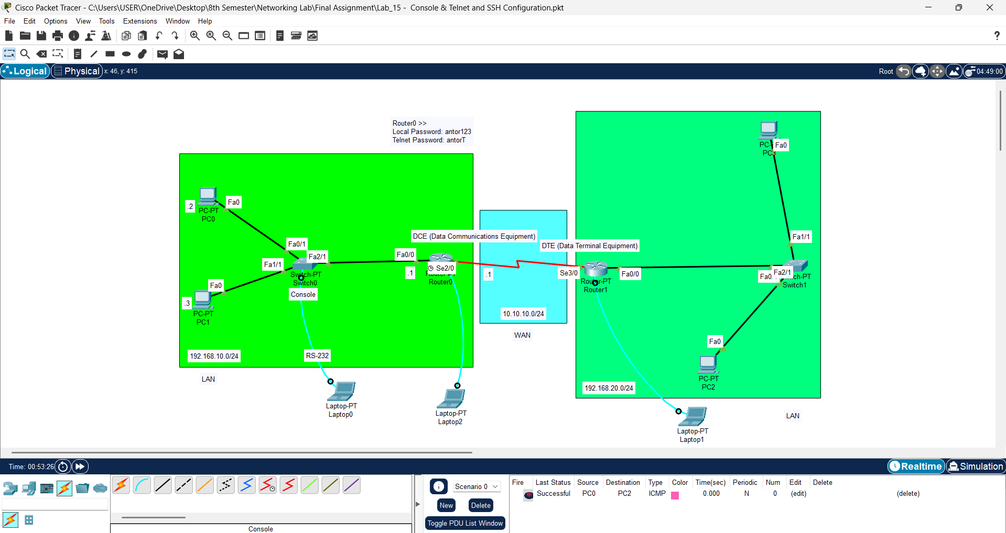
Lab 15 - Console, Telnet and SSH Configuration

Slide 35
Router Local Passoword Setup (Router0)
To configure Telnet access: (It’s provide no security)
(Router0)
For test the telnet activity (From PC2)
Router(config)#enable password antor
Router(config)#service password-encryption
Or>>
Router(config)#enable secret antor123
To Remove Password >> Router(config)#no enable password
Router(config)#line vty 0 5
Router(config-line)#password antorT
Router(config-line)#login
Router(config-line)#end
C:\>telnet router_any_active_interface
C:\>telnet 192.168.10.1
Trying 192.168.10.1 ...Open
User Access Verification
Password: antorT
Router>en
Password: antor123
Router#
More
Max >> line vty 0 15 (max 15 users)
vty >> Virtual Terminal

